Slide 1


California Telco Customer churn Analysis
Penina Wanyama
February, 2023

Slide 2
Summary
Predictive analysis of the California Telco indicate with a balanced accuracy of 76% that the Telco could retain customers and increase revenue if they could:
Move most of the month-to-Moth contract customers to one year or more
Incentivize or review the internet services offered to customers subscribed to the Fiber Optic category
Reduce the cost of services for customers on month-to-Month

Slide 3
Outline
Business Problem
Data &Methods
Modeling/Model evaluation
Conclusion/Recommendations

Slide 4
Business Problem
Understand reasons behind customer churn
Identify the segments of customers most likely to churn
Develop strategies to reduce churn and improve customer retention

Slide 5
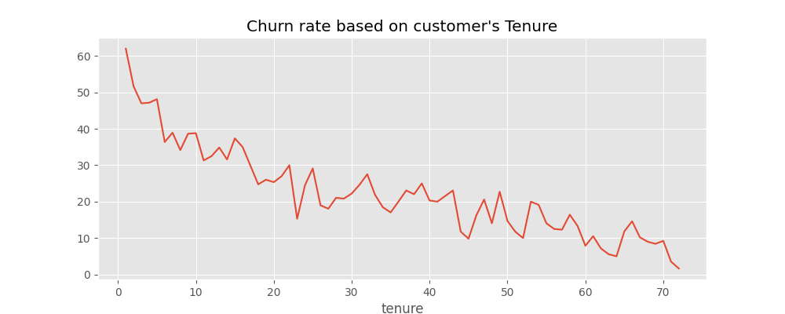
Data and Methods
Customers who churn the telco have a shorter tenure as seen the graph above

Slide 6
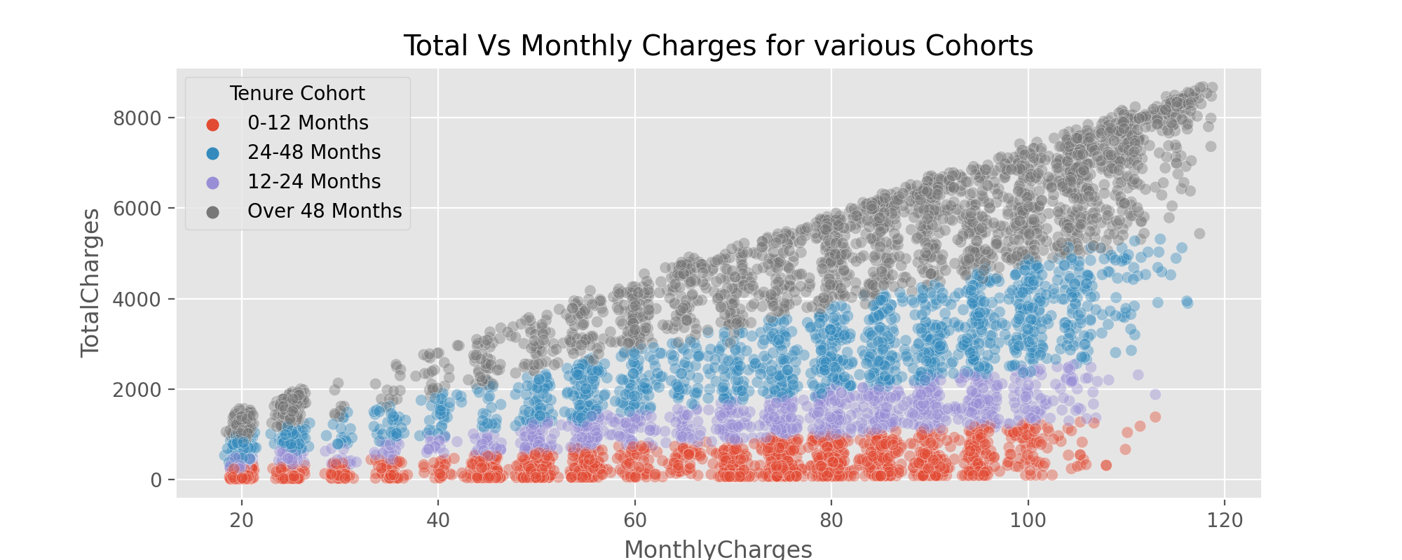
Data and Methods cont..
Total charges increase with the longer a customer stays in the company. The compony can get more revenue if they can device ways of encouraging customers stay longer

Slide 7
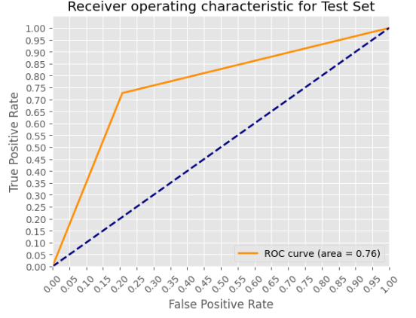
Modeling(Random Forest)-Accuracy
Our Model can classify customers into those who are about to churn and those who stay with a balanced accuracy score of 76%. There is still room for improvement as we continue researching on ways of dealing with unbalanced data

Slide 8
Conclusion
Predictive analysis of the California Telco indicate with a balanced accuracy of 76% that the Telco could retain customers and increase revenue if they could:
Move most of the month-to-Moth contract customers to one year or more
Incentivize or review the internet services offered to customers subscribed to the Fiber Optic category
Reduce the cost of services for customers on month-to-Month contracts
Interview senior citizens on what they enjoy as being customers of the company to inform on the strategy of how to attract more customers and retain new customers in the company using lessons learnt
Do a market research to learn the services their competitors are offering and improve their service strategy

Slide 9
Recommendations
More attention should be given to customers who are on month-to-Month contract and have stayed with the company for long. This can help reduce the churn rate realized in this class of contract.
customers on Month-to-Month contract don't bring more income to the company as evidenced in the in the plot above if encouraged to join the contracts more than a year. The company would gain more revenue.
A high churn rate is also seen for customers who are subscribed to the Fibre optic internet service. Better services such as online security and Tech support could help retain customer base in this sector.

Slide 10


Thank You!
Email: penina.wanyama@student.moringaschool.com
GitHub: @penina26

